Slide 1

Customer Shopping Behavior Analysis
Uncovering insights from 3,900 purchases to drive strategic business decisions

Slide 2

PROJECT OVERVIEW
Understanding Customer Patterns
The Challenge
3.9K
18
Analyze transactional data to uncover spending patterns, customer segments, and product preferences
Total Purchases
Data Points
Transactions analyzed
Features per customer
4
Categories
Product segments

Slide 3
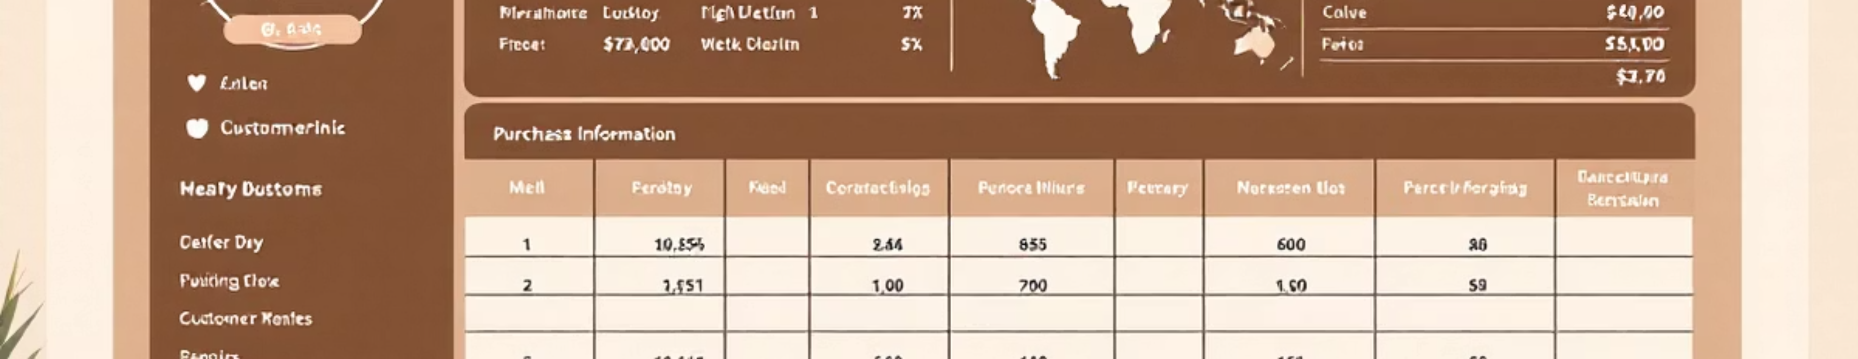
Dataset at a Glance
Demographics
Purchase Details
Shopping Behavior
Age, gender, location, subscription status
Item, category, amount, season, size, color
Discounts, promo codes, purchase history, ratings, shipping

Slide 4

PYTHON ANALYSIS
Data Preparation & Cleaning
01
Data Loading
Imported dataset using pandas
02
Exploration
Analyzed structure and summary statistics
03
Missing Data
Imputed 37 missing review ratings using median
04
Feature Engineering
Created age groups and purchase frequency columns
05
Database Integration
Loaded cleaned data into PostgreSQL

Slide 5
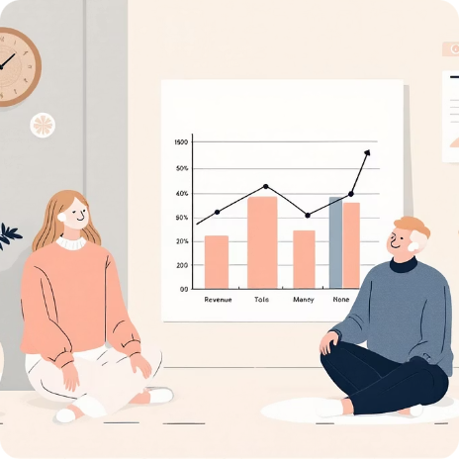



SQL ANALYSIS
Key Business Insights
Revenue by Gender
High-Spending Discount Users
Top-Rated Products
Shipping Preferences
Male: $157,890 | Female: $75,191
Gloves (3.86), Sandals (3.84), Boots (3.82)
Express: $60.48 avg | Standard: $58.46 avg
839 customers used discounts but spent above average

Slide 6
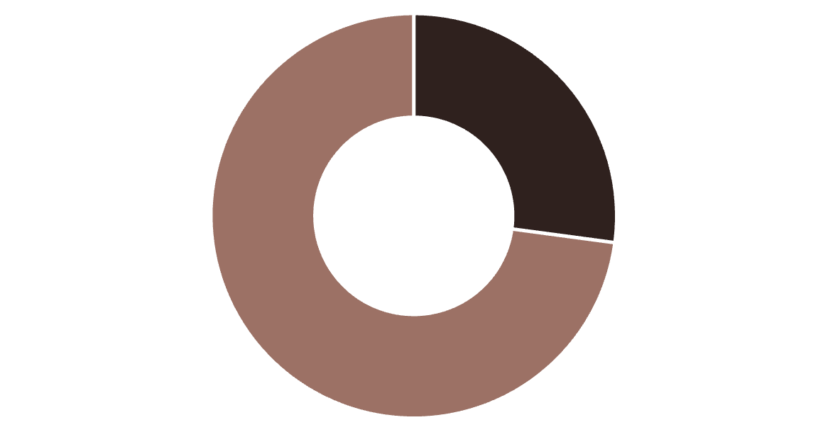
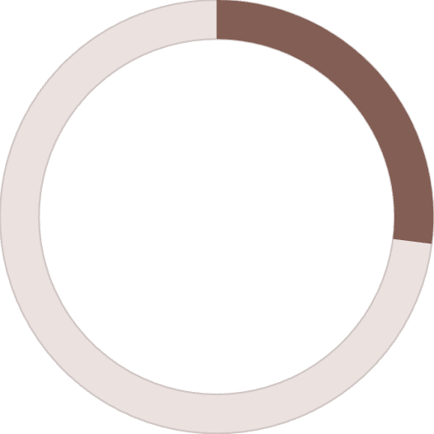

Subscription Status Analysis
The Numbers Tell a Story
Only 27% of customers subscribe, yet they contribute $62,645 in revenue.
27%
Subscribers
Non-Subscribers
Subscription Rate
73%
Non-Subscribers
Average spend is nearly identical: Subscribers $59.49 vs Non-subscribers $59.87

Slide 7



Customer Segmentation Breakdown
New
1
83 customers
Returning
2
701 customers
Loyal
3
3,116 customers
80% of customers fall into the Loyal segment, representing repeat buyers with 5+ purchases

Slide 8
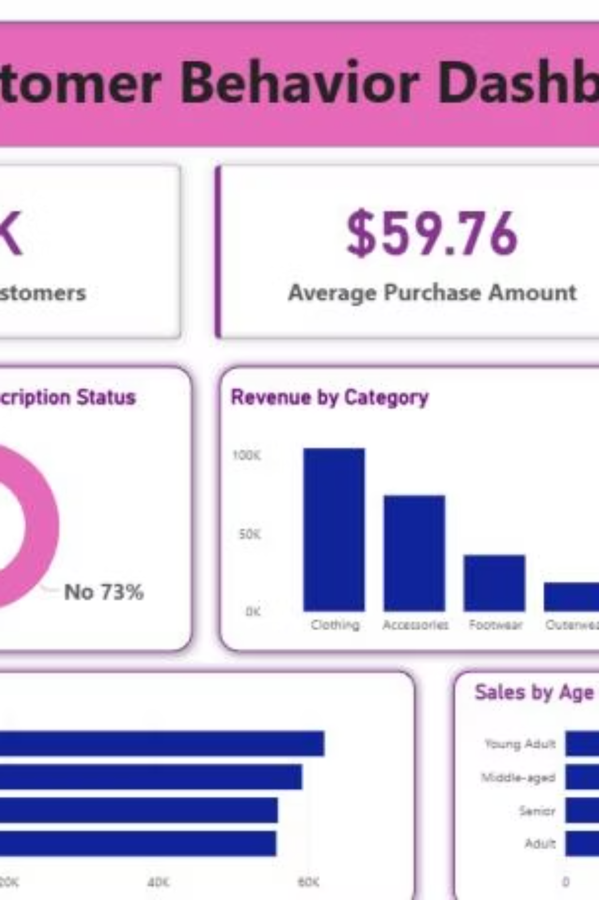
POWER BI DASHBOARD
Visual Intelligence
Interactive Dashboard Features
Key Metrics at a Glance
3.9K customers | $59.76 avg purchase | 3.75 avg rating
Real-time filtering by subscription, gender, category
Revenue and sales breakdowns by age group
Shipping type analysis

Slide 9
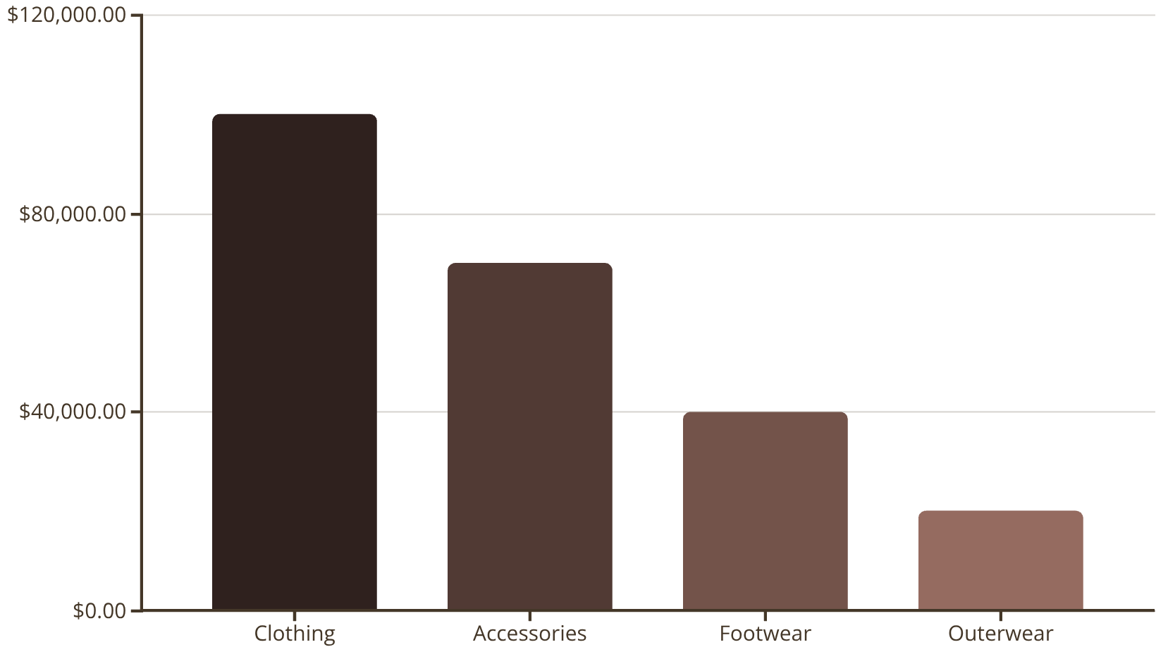
Revenue Distribution Insights
Category Performance
Clothing dominates with 43% of total revenue, followed by Accessories at 30%.
Age Group Leaders
Young Adults generate highest revenue ($62,143), followed closely by Middle-aged customers ($59,197)

Slide 10
STRATEGIC RECOMMENDATIONS
Actionable Business Strategies
Boost Subscriptions
1
Promote exclusive benefits to convert the 73% non-subscriber base
Loyalty Programs
2
Reward repeat buyers to accelerate movement into Loyal segment
Review Discount Policy
3
Balance sales boosts with margin control—839 high spenders use discounts
Product Positioning
4
Highlight top-rated items (Gloves, Sandals, Boots) in marketing campaigns
Targeted Marketing
5
Focus on Young Adults and express-shipping users for maximum ROI

